Slide 1
Identity-based Trust - Till Death Do We Part?
Kairo De Araujo - Independent
John Kjell - ControlPlane

Slide 2










Buckle Up 💺🫠

Slide 3
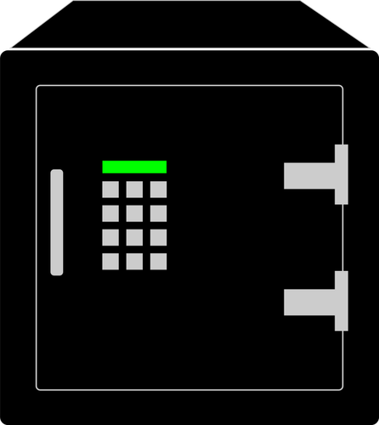







“Old days”: Key Par
Private
Private
Public
Public

Slide 4


Problems and share new trusted keys
CDN, Mirrors, …
Private
Private
Public
Public
⚠️ NEW TRUSTED KEY

Slide 5

Ephemeral Keys
OIDC

Slide 6
Ephemeral Keys
Losing keys is no longer a problem
You don’t need resign everything
Short-term certificates
Signature time-recording (Rekor and Timestamp Authority)

Slide 7
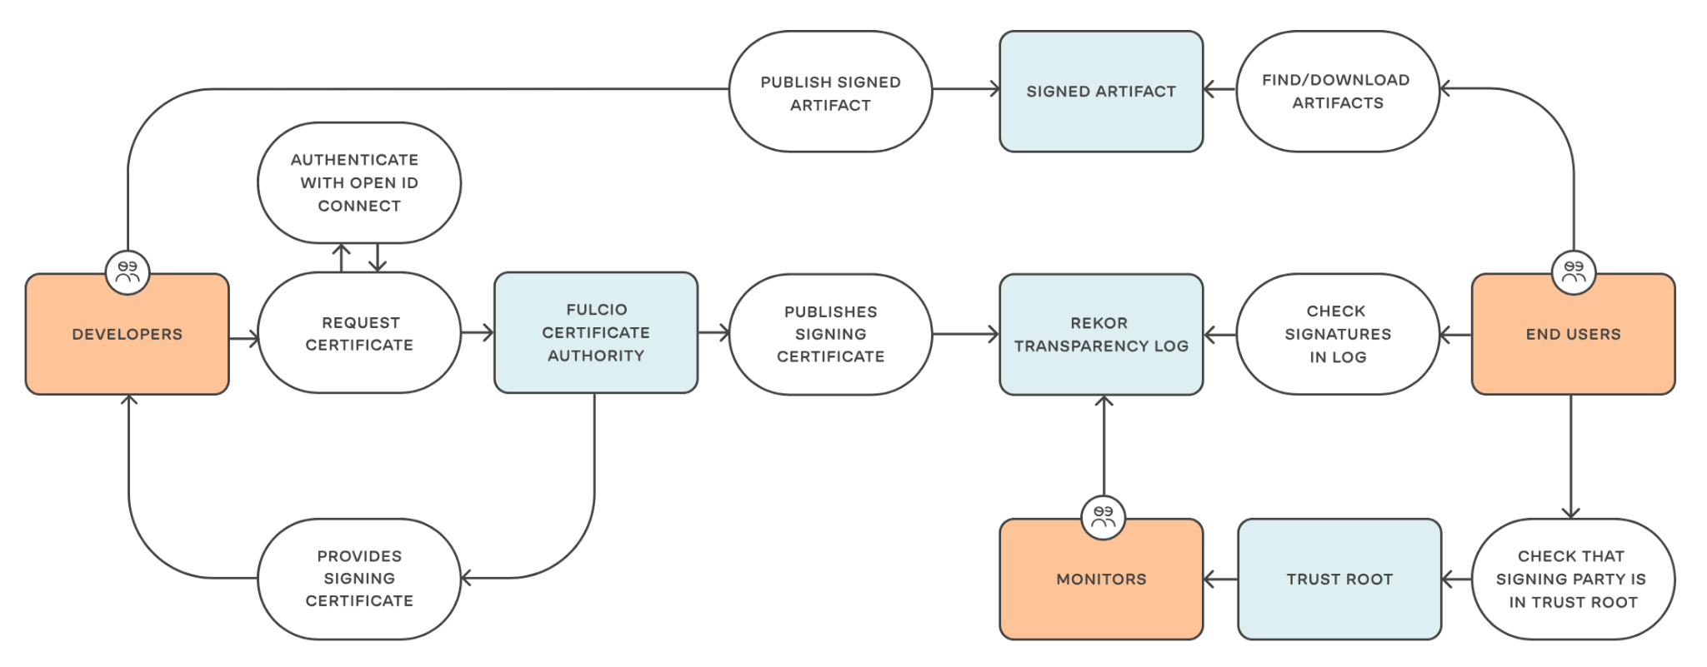

Slide 8
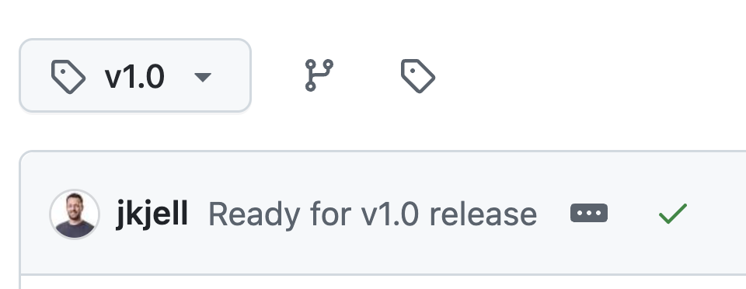
Identity-based Signing
🎉 Release - v1.0 🎉
Notes:
GitHub Repo
Role: Pipeline
Create release 1.0 from pipeline w/ witness-run-action to create SLSA attestation, stored in archivista
Add to RSTUF metadata
Role: release-approver
Witness verify w/ policy succeeds
Sign RSTUF metadata
Role: maintainer
Merge PR for “Malicious Bug Fix”
Role: app-admin
deploy 1.0
Role: pipeline
Create release 1.1 from pipeline
Add to RSTUF metadata
Role: release-approver
Witness verify w/ policy fails
Don’t sign RSTUF metadata
remove entry
Merge PR to fix release
Create release 1.2 from pipeline
Add to RSTUF metadata
Witness verify w/ policy succeeds
Sign RSTUF metadata
Still able to run 1.0
Remove 1.0 metadata
Sign RSTUF metadata
deploy 1.2

Slide 9
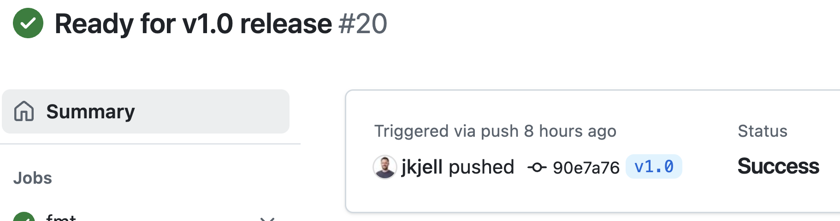
Identity-based Signing
🎉 Release - v1.0 🎉
Notes:
GitHub Repo
Role: Pipeline
Create release 1.0 from pipeline w/ witness-run-action to create SLSA attestation, stored in archivista
Add to RSTUF metadata
Role: release-approver
Witness verify w/ policy succeeds
Sign RSTUF metadata
Role: maintainer
Merge PR for “Malicious Bug Fix”
Role: app-admin
deploy 1.0
Role: pipeline
Create release 1.1 from pipeline
Add to RSTUF metadata
Role: release-approver
Witness verify w/ policy fails
Don’t sign RSTUF metadata
remove entry
Merge PR to fix release
Create release 1.2 from pipeline
Add to RSTUF metadata
Witness verify w/ policy succeeds
Sign RSTUF metadata
Still able to run 1.0
Remove 1.0 metadata
Sign RSTUF metadata
deploy 1.2

Slide 10
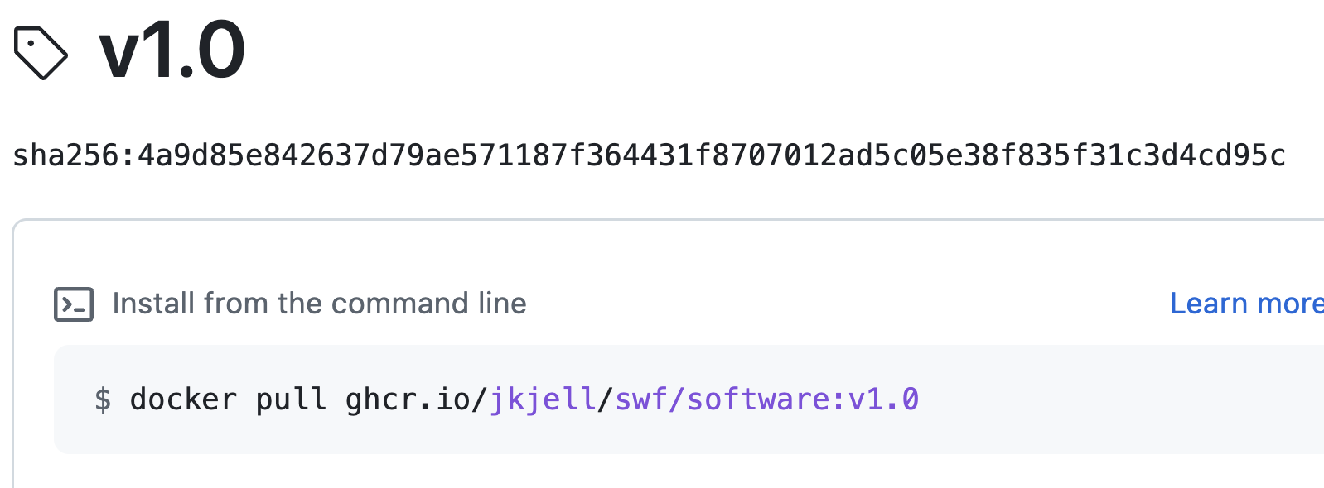
Identity-based Signing
🎉 Release - v1.0 🎉
Notes:
GitHub Repo
Role: Pipeline
Create release 1.0 from pipeline w/ witness-run-action to create SLSA attestation, stored in archivista
Add to RSTUF metadata
Role: release-approver
Witness verify w/ policy succeeds
Sign RSTUF metadata
Role: maintainer
Merge PR for “Malicious Bug Fix”
Role: app-admin
deploy 1.0
Role: pipeline
Create release 1.1 from pipeline
Add to RSTUF metadata
Role: release-approver
Witness verify w/ policy fails
Don’t sign RSTUF metadata
remove entry
Merge PR to fix release
Create release 1.2 from pipeline
Add to RSTUF metadata
Witness verify w/ policy succeeds
Sign RSTUF metadata
Still able to run 1.0
Remove 1.0 metadata
Sign RSTUF metadata
deploy 1.2

Slide 11
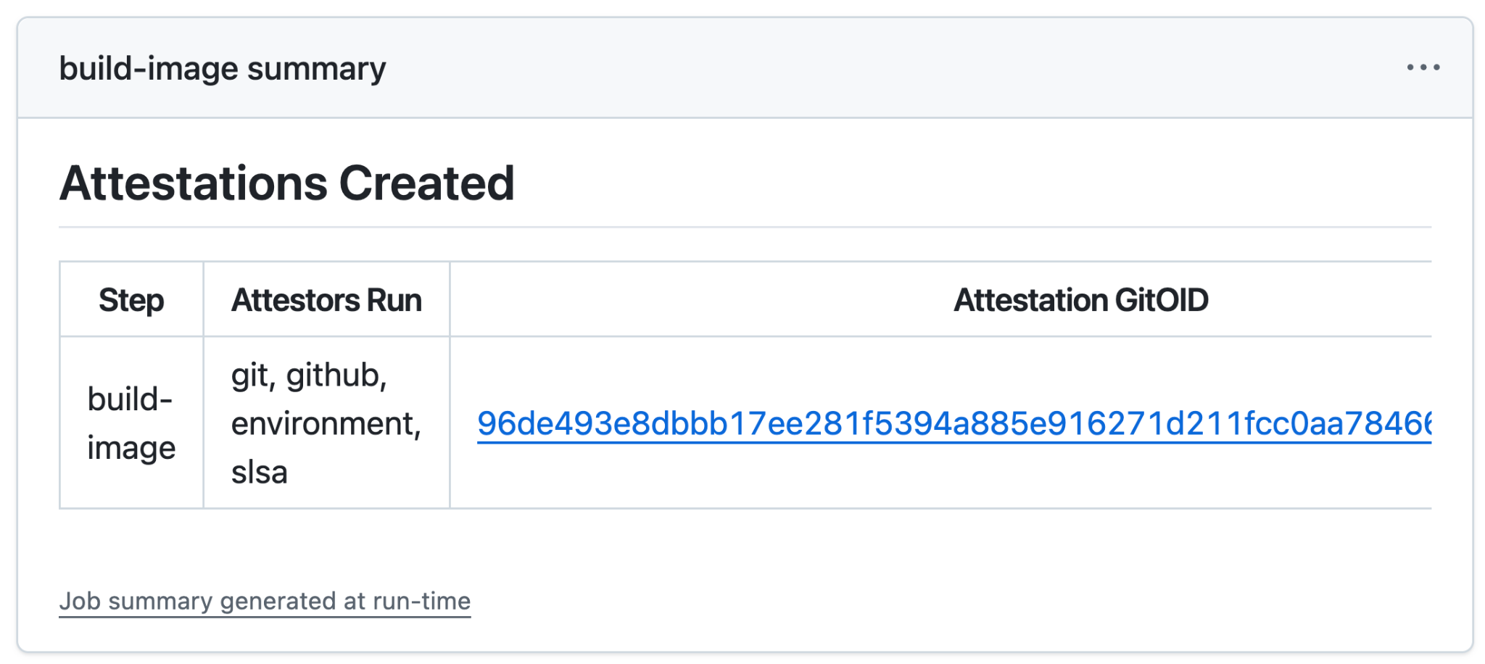
Identity-based Signing
🎉 Release - v1.0 🎉
Notes:
GitHub Repo
Role: Pipeline
Create release 1.0 from pipeline w/ witness-run-action to create SLSA attestation, stored in archivista
Add to RSTUF metadata
Role: release-approver
Witness verify w/ policy succeeds
Sign RSTUF metadata
Role: maintainer
Merge PR for “Malicious Bug Fix”
Role: app-admin
deploy 1.0
Role: pipeline
Create release 1.1 from pipeline
Add to RSTUF metadata
Role: release-approver
Witness verify w/ policy fails
Don’t sign RSTUF metadata
remove entry
Merge PR to fix release
Create release 1.2 from pipeline
Add to RSTUF metadata
Witness verify w/ policy succeeds
Sign RSTUF metadata
Still able to run 1.0
Remove 1.0 metadata
Sign RSTUF metadata
deploy 1.2

Slide 12
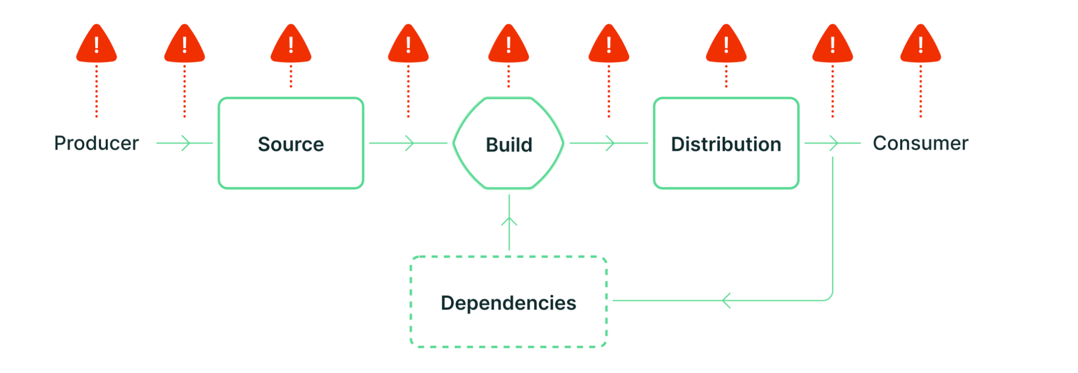
Supply Chain Threats
Title
Notes:
GitHub Repo
Role: Pipeline
Create release 1.0 from pipeline w/ witness-run-action to create SLSA attestation, stored in archivista
Add to RSTUF metadata
Role: release-approver
Witness verify w/ policy succeeds
Sign RSTUF metadata
Role: maintainer
Merge PR for “Malicious Bug Fix”
Role: app-admin
deploy 1.0
Role: pipeline
Create release 1.1 from pipeline
Add to RSTUF metadata
Role: release-approver
Witness verify w/ policy fails
Don’t sign RSTUF metadata
remove entry
Merge PR to fix release
Create release 1.2 from pipeline
Add to RSTUF metadata
Witness verify w/ policy succeeds
Sign RSTUF metadata
Still able to run 1.0
Remove 1.0 metadata
Sign RSTUF metadata
deploy 1.2

Slide 13
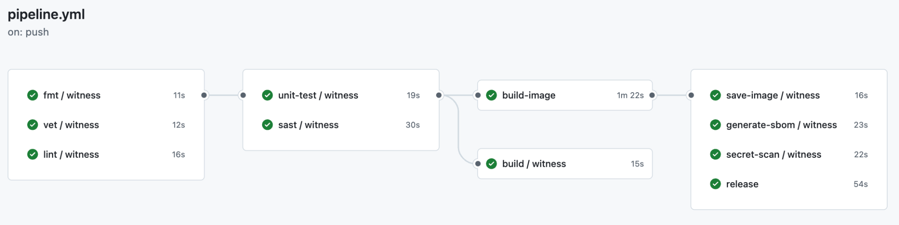

Identity-based Signing
Vulnerability Scans
Code Reviews
Testing
SAST & DAST
License Compliance
Notes:
GitHub Repo
Role: Pipeline
Create release 1.0 from pipeline w/ witness-run-action to create SLSA attestation, stored in archivista
Add to RSTUF metadata
Role: release-approver
Witness verify w/ policy succeeds
Sign RSTUF metadata
Role: maintainer
Merge PR for “Malicious Bug Fix”
Role: app-admin
deploy 1.0
Role: pipeline
Create release 1.1 from pipeline
Add to RSTUF metadata
Role: release-approver
Witness verify w/ policy fails
Don’t sign RSTUF metadata
remove entry
Merge PR to fix release
Create release 1.2 from pipeline
Add to RSTUF metadata
Witness verify w/ policy succeeds
Sign RSTUF metadata
Still able to run 1.0
Remove 1.0 metadata
Sign RSTUF metadata
deploy 1.2

Slide 14
Identity-based Signing
Demo - v1.1
Title
Notes:
GitHub Repo
Role: Pipeline
Create release 1.0 from pipeline w/ witness-run-action to create SLSA attestation, stored in archivista
Add to RSTUF metadata
Role: release-approver
Witness verify w/ policy succeeds
Sign RSTUF metadata
Role: maintainer
Merge PR for “Malicious Bug Fix”
Role: app-admin
deploy 1.0
Role: pipeline
Create release 1.1 from pipeline
Add to RSTUF metadata
Role: release-approver
Witness verify w/ policy fails
Don’t sign RSTUF metadata
remove entry
Merge PR to fix release
Create release 1.2 from pipeline
Add to RSTUF metadata
Witness verify w/ policy succeeds
Sign RSTUF metadata
Still able to run 1.0
Remove 1.0 metadata
Sign RSTUF metadata
deploy 1.2

Slide 15
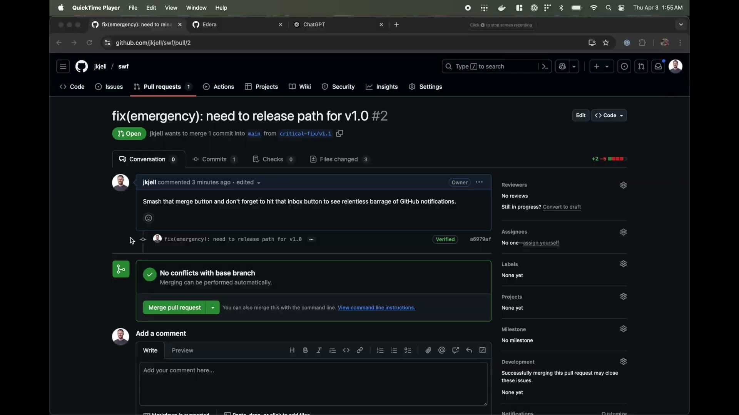
Identity-based Signing
Title
Notes:
GitHub Repo
Role: Pipeline
Create release 1.0 from pipeline w/ witness-run-action to create SLSA attestation, stored in archivista
Add to RSTUF metadata
Role: release-approver
Witness verify w/ policy succeeds
Sign RSTUF metadata
Role: maintainer
Merge PR for “Malicious Bug Fix”
Role: app-admin
deploy 1.0
Role: pipeline
Create release 1.1 from pipeline
Add to RSTUF metadata
Role: release-approver
Witness verify w/ policy fails
Don’t sign RSTUF metadata
remove entry
Merge PR to fix release
Create release 1.2 from pipeline
Add to RSTUF metadata
Witness verify w/ policy succeeds
Sign RSTUF metadata
Still able to run 1.0
Remove 1.0 metadata
Sign RSTUF metadata
deploy 1.2

Slide 16
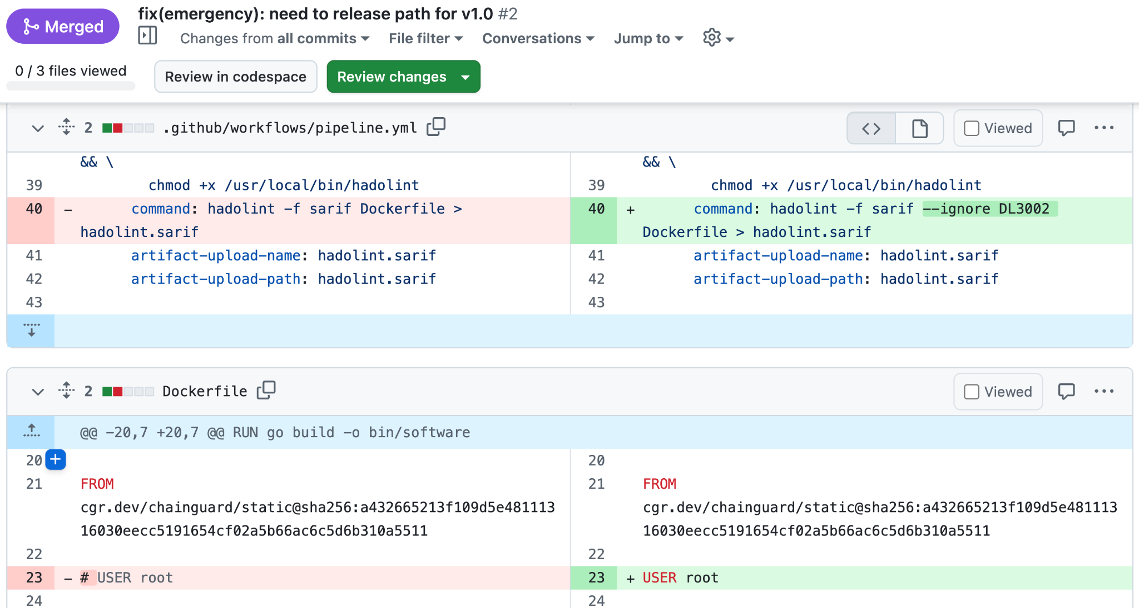
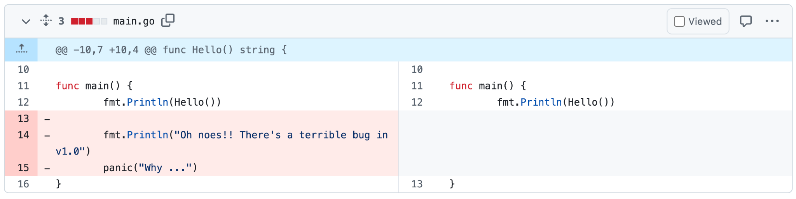
Identity-based Signing
Title
Notes:
GitHub Repo
Role: Pipeline
Create release 1.0 from pipeline w/ witness-run-action to create SLSA attestation, stored in archivista
Add to RSTUF metadata
Role: release-approver
Witness verify w/ policy succeeds
Sign RSTUF metadata
Role: maintainer
Merge PR for “Malicious Bug Fix”
Role: app-admin
deploy 1.0
Role: pipeline
Create release 1.1 from pipeline
Add to RSTUF metadata
Role: release-approver
Witness verify w/ policy fails
Don’t sign RSTUF metadata
remove entry
Merge PR to fix release
Create release 1.2 from pipeline
Add to RSTUF metadata
Witness verify w/ policy succeeds
Sign RSTUF metadata
Still able to run 1.0
Remove 1.0 metadata
Sign RSTUF metadata
deploy 1.2

Slide 17
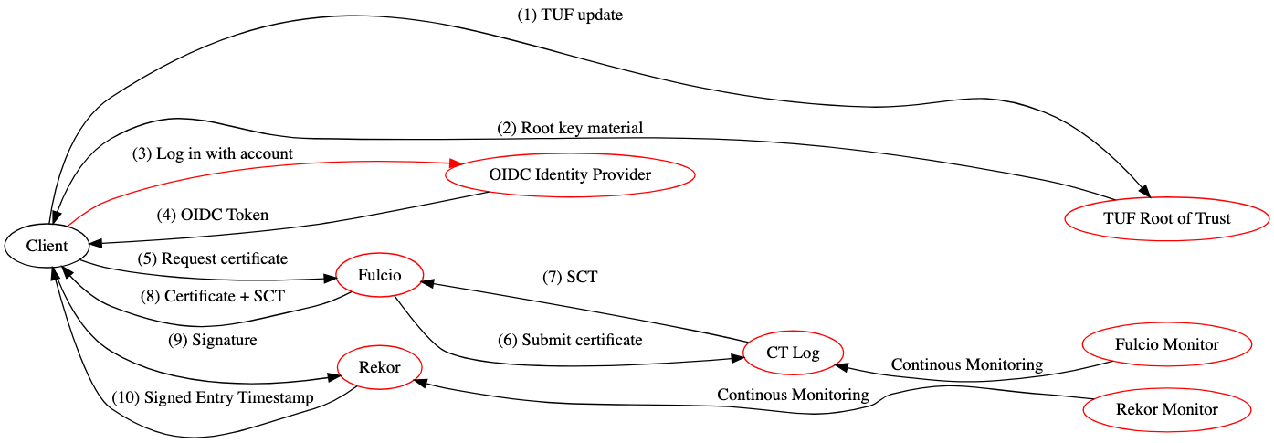
Identity-based Signing
Title
Notes:
Compromise
Attacker capabilities
Fulcio CT log monitor
None: alerts will be logged, Sigstore admins manually check reports from Deborah by querying the log and will reject false reports. If all monitors are compromised, failure of the consistency verification would be suppressed.
Rekor monitor
None: alerts are logged, maybe sent to Slack. Sigstore admins manually check reports from Charlie.
Fulcio monitor + Rekor monitor
Same as Fulcio monitor + Rekor monitor
Fulcio CT log
Can remove certificates (invalidate them) by indicating that they are not in the log when Bob queries, fork attack by showing different times or certificates to different users (for things Fulcio has signed), and may block the issuance of Fulcio certificates by not creating an SCT. Deletion / fork may be detected by Fulcio CT log monitors.
Rekor server
Can change the timestamp on Fulcio signatures used outside the validity window to make them appear valid when Bob queries. Can deny the existence of valid signatures leading to them being untrusted. Can later recover using offline delegation in Sigstore’s TUF root of trust. Deletion or fork attacks may be detected by Rekor monitors. Changes to the Rekor log would be challenging to recover as it eliminates the append-only promise of Rekor.
Fulcio CT log + Fulcio monitor
Same as Fulcio CT log, but bad behavior will not be detected if all monitors are compromised, so replay and fork attacks are undetected.
Fulcio CT log + Rekor server
Same as Fulcio CT log + Rekor server: can now use the replayed certs created by Fulcio CT log because Rekor will not report that they are already in the log, even with more sophisticated monitors.
Rekor monitor + Rekor server
Same as Rekor server, but changes to the CT log would not be reported by the monitor, would make recovery of the log much harder because the attacker could alter the historical entries, recovery may require re-signing all metadata as previous timestamps are untrusted.
Fulcio CT log + Fulcio monitor + Rekor server
Same as [Fulcio CT log + Rekor server], but replay and fork attacks will not be reported by monitors.
Fulcio CA server
OR
Fulcio CA server + Fulcio monitor
OR
Fulcio CA server + Rekor monitor
Arbitrary software attack: Can issue certs for any OIDC issuer/identity and use those to sign any software desired. Bob will see these certificates as valid as they are signed by the Fulcio CA and included in the Fulcio CT log. To recover, the TUF root of trust for Fulcio needs to be invoked to revoke trust in the compromised Fulcio CA server. If the Fulcio CT log is working, then you cannot change the history or block issuance / modification of past things (which is not that relevant given the ability to issue keys, etc. now), DDoS attack: the attacker could take down the cert issuing service, preventing both Alice and Bob from accessing it. The possibility of the attack could be mitigated by using service for Fulcio with DDoS detection, such as cloudflare.
Fulcio CA server + Fulcio CT log
Arbitrary software attack: Same as Fulcio CA server, but can now also rewrite historical Fulcio certificates in the Fulcio CT log by changing the Merkle tree hash so that the times will appear different when Bob queries. Modifying CT log history would be caught by the Fulcio monitor. Can recover using the Sigstore root of trust.
Fulcio CA server + Rekor server
Fulcio CA server + Rekor compromise capabilities. The recovery is harder than just Fulcio CA server or Rekor server compromise because the history of both tables may be lost.
Fulcio CA server + Fulcio CT log + Fulcio monitor
Same as [Fulcio CA server + Fulcio CT], but replay and fork attacks will not be reported by the monitors.
OIDC account
Fulcio monitor + OIDC account
Rekor monitor + OIDC account
Arbitrary software attack for whatever that specific account has access to, might be recoverable through a mechanism set up by the OIDC server.
Fulcio CT log + OIDC account
Same as Fulcio CT log + OIDC account
Rekor server + OIDC account
Same as OIDC account + Rekor server
Fulcio CA server + OIDC account
Same as OIDC account + Fulcio. OIDC cannot recover, Fulcio is not account limited
OIDC server
Arbitrary software attack for anything that OIDC domain covers
Fulcio CT log + OIDC server
Same as Fulcio CT log + OIDC server
Rekor server + OIDC server
Same as OIDC server + Rekor server
Fulcio CA server + OIDC server
Same as OIDC server + Fulcio. OIDC cannot recover, Fulcio is not domain limited
Sigstore root of trust (threshold of root keys)
Can become the Fulcio CA, Rekor, the Fulcio CA log, etc. Arbitrary software attack is trivial from there with MITM. Monitors may detect the attack, but Sigstore admins can’t recover without control of the root of trust.

Slide 18
Identity-based Signing
You’re human and you release bad software 🐛
Title
Notes:
GitHub Repo
Role: Pipeline
Create release 1.0 from pipeline w/ witness-run-action to create SLSA attestation, stored in archivista
Add to RSTUF metadata
Role: release-approver
Witness verify w/ policy succeeds
Sign RSTUF metadata
Role: maintainer
Merge PR for “Malicious Bug Fix”
Role: app-admin
deploy 1.0
Role: pipeline
Create release 1.1 from pipeline
Add to RSTUF metadata
Role: release-approver
Witness verify w/ policy fails
Don’t sign RSTUF metadata
remove entry
Merge PR to fix release
Create release 1.2 from pipeline
Add to RSTUF metadata
Witness verify w/ policy succeeds
Sign RSTUF metadata
Still able to run 1.0
Remove 1.0 metadata
Sign RSTUF metadata
deploy 1.2

Slide 19
Identity-based Signing
Demo - v1.2
Title
Notes:
GitHub Repo
Role: Pipeline
Create release 1.0 from pipeline w/ witness-run-action to create SLSA attestation, stored in archivista
Add to RSTUF metadata
Role: release-approver
Witness verify w/ policy succeeds
Sign RSTUF metadata
Role: maintainer
Merge PR for “Malicious Bug Fix”
Role: app-admin
deploy 1.0
Role: pipeline
Create release 1.1 from pipeline
Add to RSTUF metadata
Role: release-approver
Witness verify w/ policy fails
Don’t sign RSTUF metadata
remove entry
Merge PR to fix release
Create release 1.2 from pipeline
Add to RSTUF metadata
Witness verify w/ policy succeeds
Sign RSTUF metadata
Still able to run 1.0
Remove 1.0 metadata
Sign RSTUF metadata
deploy 1.2

Slide 20
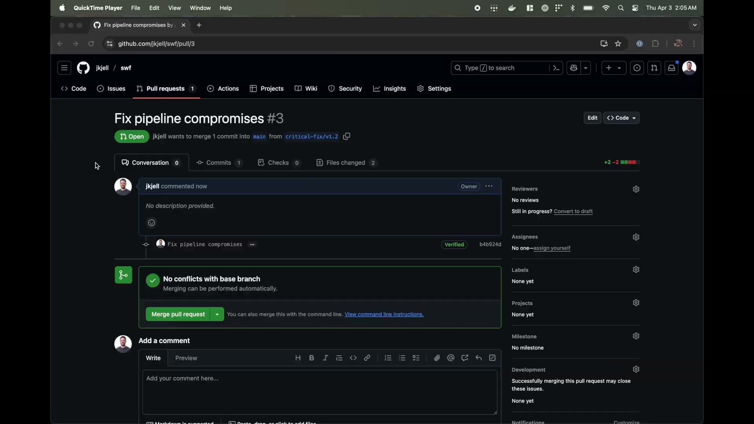
Identity-based Signing
Title
Notes:
GitHub Repo
Role: Pipeline
Create release 1.0 from pipeline w/ witness-run-action to create SLSA attestation, stored in archivista
Add to RSTUF metadata
Role: release-approver
Witness verify w/ policy succeeds
Sign RSTUF metadata
Role: maintainer
Merge PR for “Malicious Bug Fix”
Role: app-admin
deploy 1.0
Role: pipeline
Create release 1.1 from pipeline
Add to RSTUF metadata
Role: release-approver
Witness verify w/ policy fails
Don’t sign RSTUF metadata
remove entry
Merge PR to fix release
Create release 1.2 from pipeline
Add to RSTUF metadata
Witness verify w/ policy succeeds
Sign RSTUF metadata
Still able to run 1.0
Remove 1.0 metadata
Sign RSTUF metadata
deploy 1.2

Slide 21
TUF: Securing the content distribution

Slide 22
Identity-based Signing
Demo - v1.2
Title
Notes:
GitHub Repo
Role: Pipeline
Create release 1.0 from pipeline w/ witness-run-action to create SLSA attestation, stored in archivista
Add to RSTUF metadata
Role: release-approver
Witness verify w/ policy succeeds
Sign RSTUF metadata
Role: maintainer
Merge PR for “Malicious Bug Fix”
Role: app-admin
deploy 1.0
Role: pipeline
Create release 1.1 from pipeline
Add to RSTUF metadata
Role: release-approver
Witness verify w/ policy fails
Don’t sign RSTUF metadata
remove entry
Merge PR to fix release
Create release 1.2 from pipeline
Add to RSTUF metadata
Witness verify w/ policy succeeds
Sign RSTUF metadata
Still able to run 1.0
Remove 1.0 metadata
Sign RSTUF metadata
deploy 1.2

Slide 23
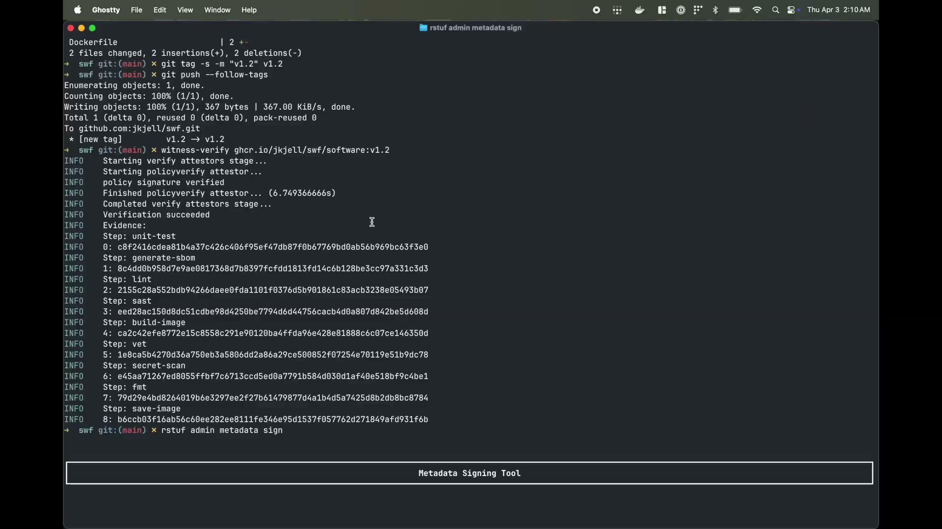
Identity-based Signing
Title
Notes:
GitHub Repo
Role: Pipeline
Create release 1.0 from pipeline w/ witness-run-action to create SLSA attestation, stored in archivista
Add to RSTUF metadata
Role: release-approver
Witness verify w/ policy succeeds
Sign RSTUF metadata
Role: maintainer
Merge PR for “Malicious Bug Fix”
Role: app-admin
deploy 1.0
Role: pipeline
Create release 1.1 from pipeline
Add to RSTUF metadata
Role: release-approver
Witness verify w/ policy fails
Don’t sign RSTUF metadata
remove entry
Merge PR to fix release
Create release 1.2 from pipeline
Add to RSTUF metadata
Witness verify w/ policy succeeds
Sign RSTUF metadata
Still able to run 1.0
Remove 1.0 metadata
Sign RSTUF metadata
deploy 1.2

Slide 24








TUF: How it works
TUF metadata storage
HTTP/S
swf/software:1.2 ✅🔐
Not found
Validate hash and size
Artifact Storage
Download sw/software:1.0
TUF Client
(root v1)
Download swf/software:1.2
Check for new Root
Snapshot (V56)
Signed: [E]
Targets v10
swf-software v31
project-bar v9
swf/software:1.0
swf/software:1.1 swf/software:1.2
Download timestamp
Timestamp
Signed: [E] Snapshot v56
Download snapshot
Download Targets
Targets (V10)
Keys: [F,G,H,I,J,K]
Signed: [E]
swf-software: sw/* [F,G,H]
project-bar: bar/* [I,J,K]
Root (V1)
Keys: [A,B,C]
Signed: [A,C]
Root (V2)
Keys: [B,C,D]
Signed: [B,C]
Root (V3)
Keys: [B,D,C,E]
Signed: [B,C]
swf-software (V31)
Signed: [F,G]
swf/software:1.0 hash/size
swf/software:1.2 hash/size

Slide 25
TUF: How it works
TUF metadata storage
HTTP/S
swf/software:1.1 ❌🔐
Validate hash and size
Artifact Storage
TUF Client
(root v1)
Download swf/software:1.1
Snapshot (V56)
Signed: [E]
Targets v10
swf-software v31
project-bar v9
swf/software:1.0
swf/software:1.1 swf/software:1.2
Timestamp
Signed: [E] Snapshot v56
Targets (V10)
Keys: [F,G,H,I,J,K]
Signed: [E]
swf-software: sw/* [F,G,H]
project-bar: bar/* [I,J,K]
Root (V1)
Keys: [A,B,C]
Signed: [A,C]
Root (V2)
Keys: [B,C,D]
Signed: [B,C]
Root (V3)
Keys: [B,D,C,E]
Signed: [B,C]
swf-software (V31)
Signed: [F,G]
swf/software:1.0 hash/size
swf/software:1.2 hash/size

Slide 26



Become a Mentor for Underrepresented Groups in Open Source!
Passionate about fostering an inclusive open source community?
Title
Sign up today!
https://bit.ly/cncf-inclusive-mentor
Notes:
The TAG Contributor Strategy is launching a new mentorship program
If you're interested in mentoring people from underrepresented groups, please sign up
You'll find more info in the sign up form

Slide 28
Identity-based Trust
With the rise in adoption of identity-based trust, it is increasingly important to understand the threats to such systems. PyPI, NPM, RubyGems, and Homebrew have all established models for “trusted publishing” attestation, based on OIDC. Many of these implementations rely on Project Sigstore’s projects Fulcio and Rekor.
Sigstore’s Rekor is an append only log. There’s no way to remove entries, even if they’re illegitimate. In the case of an identity compromise, most individuals would prefer to avoid a divorce from their identity, allowing for recovery and the establishment in future trust of their name.
In this session, we’ll examine a threat model and mechanisms for compromise in a Sigstore-based identity signing system. Once established, we’ll describe ways to mitigate and resolve the threats, leveraging the CNCF projects in-toto and The Update Framework (TUF). Beyond theoretical designs, we’ll look at how this system has been implemented in in-toto’s sub-project Archivista.

Slide 29
Identity-based Signing
Why
Increasing Threat Landscape
Increased Trust
Increased Transparency
Deal with key management problems
Who
Software producers
IdPs - CI/CD infrastructures
Anyone who wants to establish trust
What - Basically anything - 👇🏼 The kind of things you likely care about
Software
Container Images
Language packages - RubyGems, PyPi, NPM, Maven
Helm Charts, OPA bundles, K8s Manifests
Metadata - data about the software
Attestations
SBOMs
Where
Attached - Cosign image signature
Wrapped - DSSE attestation
Title

Slide 30
Identity-based Signing
The old days - key/pairs
Were connected to your identity
Human -
Organization - RPM -
share your key through trusted communication
Problems
Lose your key
communicate loss
create a new key
resign everything
The new way -
ephemeral keys
What if it leaks? don’t need to resign everything
Verification
short-lived certificates
time recording of the signature
Rekor to TSA
Title

Slide 31
Identity-based Signing
Monitor
Malicious
Supply chain compromise
Human error - buggy release
Vulnerabilities - Log4j Downloads
Title
Notes:
Compromise
Attacker capabilities
Fulcio CT log monitor
None: alerts will be logged, Sigstore admins manually check reports from Deborah by querying the log and will reject false reports. If all monitors are compromised, failure of the consistency verification would be suppressed.
Rekor monitor
None: alerts are logged, maybe sent to Slack. Sigstore admins manually check reports from Charlie.
Fulcio monitor + Rekor monitor
Same as Fulcio monitor + Rekor monitor
Fulcio CT log
Can remove certificates (invalidate them) by indicating that they are not in the log when Bob queries, fork attack by showing different times or certificates to different users (for things Fulcio has signed), and may block the issuance of Fulcio certificates by not creating an SCT. Deletion / fork may be detected by Fulcio CT log monitors.
Rekor server
Can change the timestamp on Fulcio signatures used outside the validity window to make them appear valid when Bob queries. Can deny the existence of valid signatures leading to them being untrusted. Can later recover using offline delegation in Sigstore’s TUF root of trust. Deletion or fork attacks may be detected by Rekor monitors. Changes to the Rekor log would be challenging to recover as it eliminates the append-only promise of Rekor.
Fulcio CT log + Fulcio monitor
Same as Fulcio CT log, but bad behavior will not be detected if all monitors are compromised, so replay and fork attacks are undetected.
Fulcio CT log + Rekor server
Same as Fulcio CT log + Rekor server: can now use the replayed certs created by Fulcio CT log because Rekor will not report that they are already in the log, even with more sophisticated monitors.
Rekor monitor + Rekor server
Same as Rekor server, but changes to the CT log would not be reported by the monitor, would make recovery of the log much harder because the attacker could alter the historical entries, recovery may require re-signing all metadata as previous timestamps are untrusted.
Fulcio CT log + Fulcio monitor + Rekor server
Same as [Fulcio CT log + Rekor server], but replay and fork attacks will not be reported by monitors.
Fulcio CA server
OR
Fulcio CA server + Fulcio monitor
OR
Fulcio CA server + Rekor monitor
Arbitrary software attack: Can issue certs for any OIDC issuer/identity and use those to sign any software desired. Bob will see these certificates as valid as they are signed by the Fulcio CA and included in the Fulcio CT log. To recover, the TUF root of trust for Fulcio needs to be invoked to revoke trust in the compromised Fulcio CA server. If the Fulcio CT log is working, then you cannot change the history or block issuance / modification of past things (which is not that relevant given the ability to issue keys, etc. now), DDoS attack: the attacker could take down the cert issuing service, preventing both Alice and Bob from accessing it. The possibility of the attack could be mitigated by using service for Fulcio with DDoS detection, such as cloudflare.
Fulcio CA server + Fulcio CT log
Arbitrary software attack: Same as Fulcio CA server, but can now also rewrite historical Fulcio certificates in the Fulcio CT log by changing the Merkle tree hash so that the times will appear different when Bob queries. Modifying CT log history would be caught by the Fulcio monitor. Can recover using the Sigstore root of trust.
Fulcio CA server + Rekor server
Fulcio CA server + Rekor compromise capabilities. The recovery is harder than just Fulcio CA server or Rekor server compromise because the history of both tables may be lost.
Fulcio CA server + Fulcio CT log + Fulcio monitor
Same as [Fulcio CA server + Fulcio CT], but replay and fork attacks will not be reported by the monitors.
OIDC account
Fulcio monitor + OIDC account
Rekor monitor + OIDC account
Arbitrary software attack for whatever that specific account has access to, might be recoverable through a mechanism set up by the OIDC server.
Fulcio CT log + OIDC account
Same as Fulcio CT log + OIDC account
Rekor server + OIDC account
Same as OIDC account + Rekor server
Fulcio CA server + OIDC account
Same as OIDC account + Fulcio. OIDC cannot recover, Fulcio is not account limited
OIDC server
Arbitrary software attack for anything that OIDC domain covers
Fulcio CT log + OIDC server
Same as Fulcio CT log + OIDC server
Rekor server + OIDC server
Same as OIDC server + Rekor server
Fulcio CA server + OIDC server
Same as OIDC server + Fulcio. OIDC cannot recover, Fulcio is not domain limited
Sigstore root of trust (threshold of root keys)
Can become the Fulcio CA, Rekor, the Fulcio CA log, etc. Arbitrary software attack is trivial from there with MITM. Monitors may detect the attack, but Sigstore admins can’t recover without control of the root of trust.

Slide 32
Identity-based Signing
Add previous signature into TUF metadata
Discover compromise via Rekor Monitor
Verify - Still Passes
Remove TUF metadata
Verify - Now Fails
Title
Notes:
Compromise
Attacker capabilities
Fulcio CT log monitor
None: alerts will be logged, Sigstore admins manually check reports from Deborah by querying the log and will reject false reports. If all monitors are compromised, failure of the consistency verification would be suppressed.
Rekor monitor
None: alerts are logged, maybe sent to Slack. Sigstore admins manually check reports from Charlie.
Fulcio monitor + Rekor monitor
Same as Fulcio monitor + Rekor monitor
Fulcio CT log
Can remove certificates (invalidate them) by indicating that they are not in the log when Bob queries, fork attack by showing different times or certificates to different users (for things Fulcio has signed), and may block the issuance of Fulcio certificates by not creating an SCT. Deletion / fork may be detected by Fulcio CT log monitors.
Rekor server
Can change the timestamp on Fulcio signatures used outside the validity window to make them appear valid when Bob queries. Can deny the existence of valid signatures leading to them being untrusted. Can later recover using offline delegation in Sigstore’s TUF root of trust. Deletion or fork attacks may be detected by Rekor monitors. Changes to the Rekor log would be challenging to recover as it eliminates the append-only promise of Rekor.
Fulcio CT log + Fulcio monitor
Same as Fulcio CT log, but bad behavior will not be detected if all monitors are compromised, so replay and fork attacks are undetected.
Fulcio CT log + Rekor server
Same as Fulcio CT log + Rekor server: can now use the replayed certs created by Fulcio CT log because Rekor will not report that they are already in the log, even with more sophisticated monitors.
Rekor monitor + Rekor server
Same as Rekor server, but changes to the CT log would not be reported by the monitor, would make recovery of the log much harder because the attacker could alter the historical entries, recovery may require re-signing all metadata as previous timestamps are untrusted.
Fulcio CT log + Fulcio monitor + Rekor server
Same as [Fulcio CT log + Rekor server], but replay and fork attacks will not be reported by monitors.
Fulcio CA server
OR
Fulcio CA server + Fulcio monitor
OR
Fulcio CA server + Rekor monitor
Arbitrary software attack: Can issue certs for any OIDC issuer/identity and use those to sign any software desired. Bob will see these certificates as valid as they are signed by the Fulcio CA and included in the Fulcio CT log. To recover, the TUF root of trust for Fulcio needs to be invoked to revoke trust in the compromised Fulcio CA server. If the Fulcio CT log is working, then you cannot change the history or block issuance / modification of past things (which is not that relevant given the ability to issue keys, etc. now), DDoS attack: the attacker could take down the cert issuing service, preventing both Alice and Bob from accessing it. The possibility of the attack could be mitigated by using service for Fulcio with DDoS detection, such as cloudflare.
Fulcio CA server + Fulcio CT log
Arbitrary software attack: Same as Fulcio CA server, but can now also rewrite historical Fulcio certificates in the Fulcio CT log by changing the Merkle tree hash so that the times will appear different when Bob queries. Modifying CT log history would be caught by the Fulcio monitor. Can recover using the Sigstore root of trust.
Fulcio CA server + Rekor server
Fulcio CA server + Rekor compromise capabilities. The recovery is harder than just Fulcio CA server or Rekor server compromise because the history of both tables may be lost.
Fulcio CA server + Fulcio CT log + Fulcio monitor
Same as [Fulcio CA server + Fulcio CT], but replay and fork attacks will not be reported by the monitors.
OIDC account
Fulcio monitor + OIDC account
Rekor monitor + OIDC account
Arbitrary software attack for whatever that specific account has access to, might be recoverable through a mechanism set up by the OIDC server.
Fulcio CT log + OIDC account
Same as Fulcio CT log + OIDC account
Rekor server + OIDC account
Same as OIDC account + Rekor server
Fulcio CA server + OIDC account
Same as OIDC account + Fulcio. OIDC cannot recover, Fulcio is not account limited
OIDC server
Arbitrary software attack for anything that OIDC domain covers
Fulcio CT log + OIDC server
Same as Fulcio CT log + OIDC server
Rekor server + OIDC server
Same as OIDC server + Rekor server
Fulcio CA server + OIDC server
Same as OIDC server + Fulcio. OIDC cannot recover, Fulcio is not domain limited
Sigstore root of trust (threshold of root keys)
Can become the Fulcio CA, Rekor, the Fulcio CA log, etc. Arbitrary software attack is trivial from there with MITM. Monitors may detect the attack, but Sigstore admins can’t recover without control of the root of trust.

